Slide 1
CaIntegrator2 & NCIA Meeting Agenda
Brief CaIntegrator2 Overview
Current Plans for Image Viewing
Short term: linking to NCIA
Long term: use a DICOM viewer
General NCIA Subject ID Question
Do NCIA Subject IDs mean anything outside of NCIA?
VASARI Data Requirements
We need mapping of Clinical Subject ID to Image Series ID
We need Representative Image IDs for each Image Series ID
We could use some input of how best to use the multiple Studies and Image Series for each subject

Slide 2
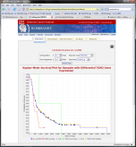
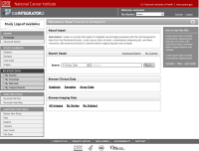
CaIntegrator2 Overview
Array Data
Software Development Team
Project Team
Public
Project Team
Clinical Data
Rembrandt (for example)
Imaging Data
caIntegrator (old)
Process repeated again for each project
caIntegrator2 (new)
Software Development Team
Study Manager deploys study using caIntegrator2 web interface
caIntegrator2
Project Team
Public
caIntegrator2
Array Data
caArray
Project Team
Clinical Data
TBD
Old and new caIntegrators provides data browsing, querying and analysis capabilities
Imaging Data
NCIA

Slide 3
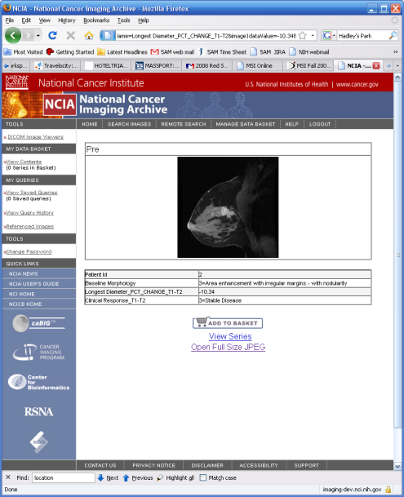
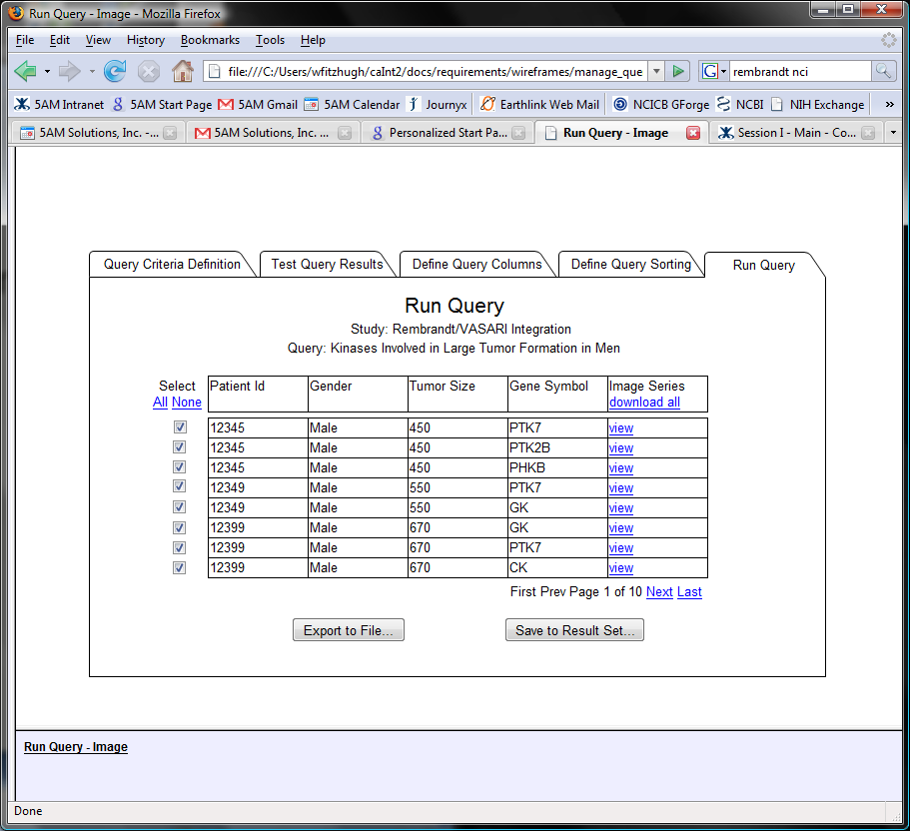
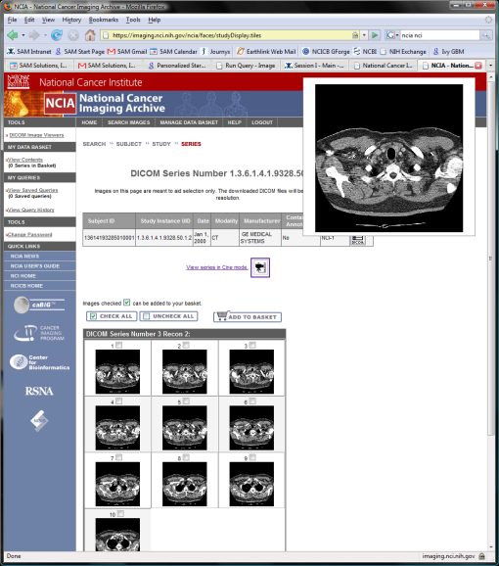
Current Plans for Image Viewing

